Slide 1
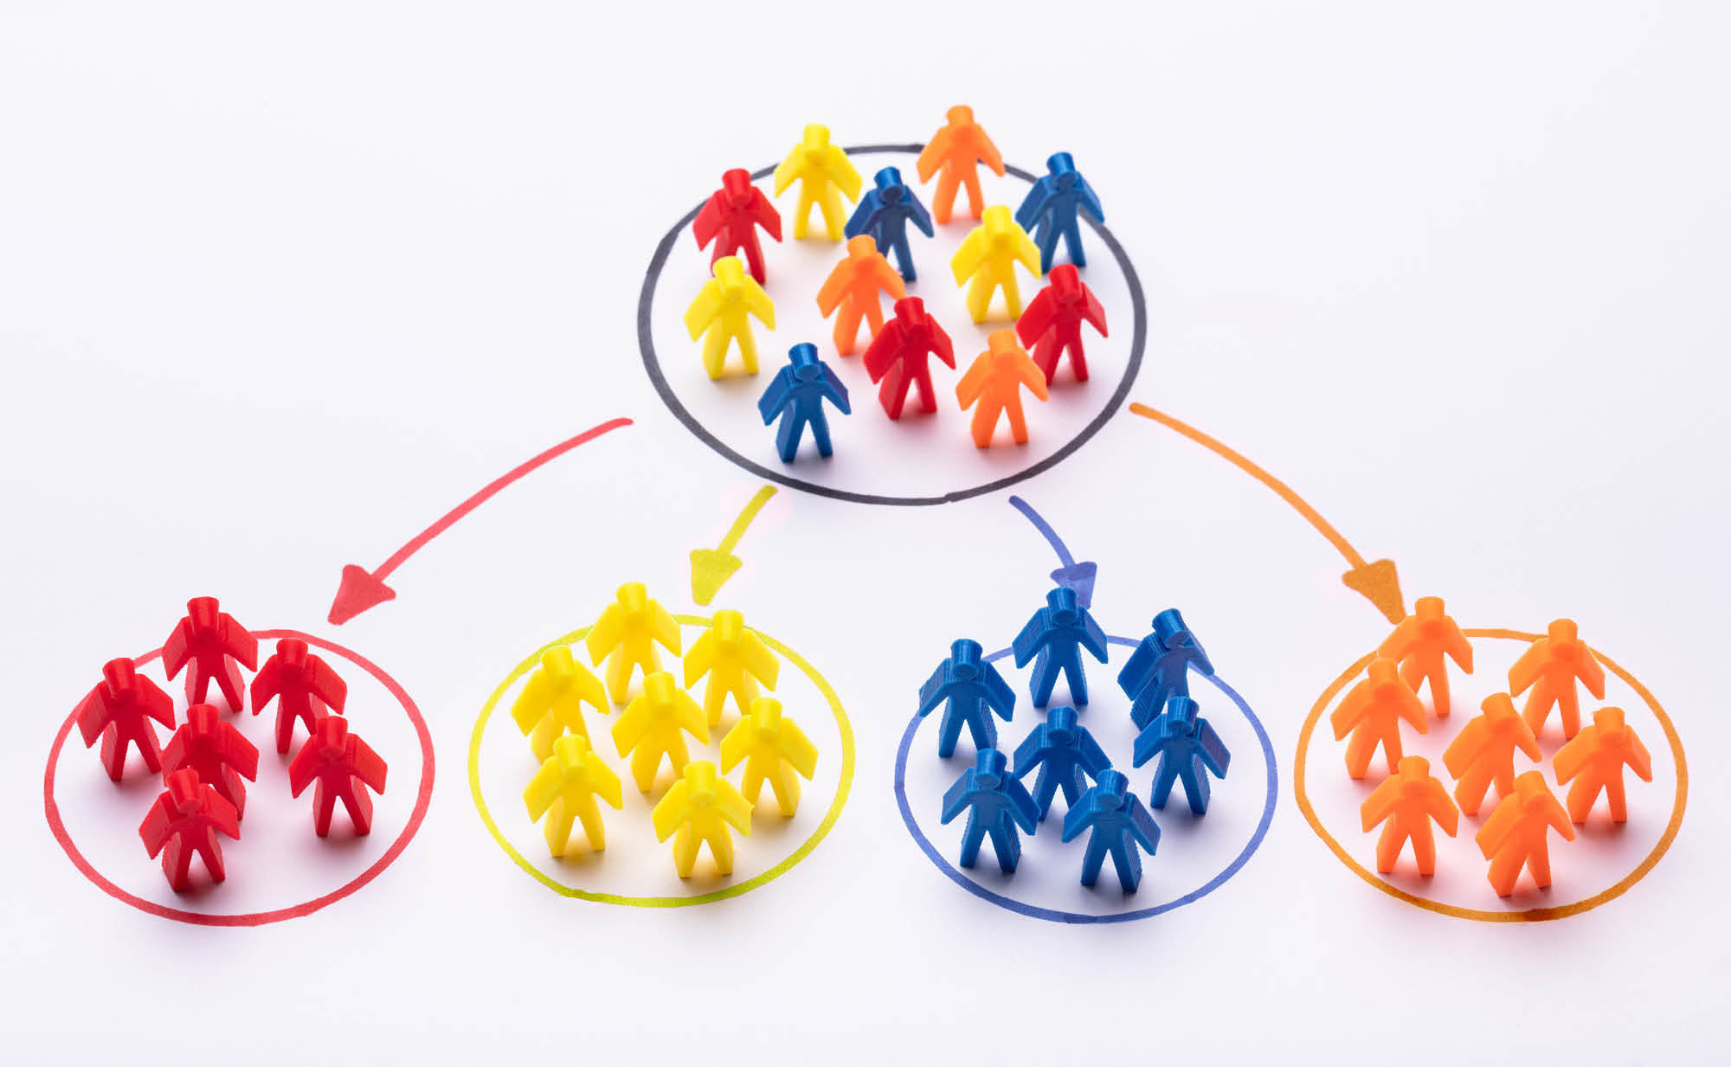
CUSTOMER SEGMENTATION AND PROFILING
Presenter : Basabdatta Ray

Slide 2
Business Objective
Problem Definition :
A wholesale food distributor of Portugal wants to study it’s customers purchase history based on different features. It includes the annual spending in monetary units (m.u.) on diverse product lines.
Objective:
The aim of the project is to perform clustering analysis on customer profiles and provide inferences accordingly. The goal here isn’t just to build clusters, but to make good and meaningful inferences based on the clusters.
Why To Do This Project:
Customers are the key to any business. To understand customer behavior and to better allocate resources to different customers to generate the highest profit, it is necessary to be able to identify and segment different types of customers. By better understanding the different types of customers, businesses can be better equipped to develop successful strategies, it will also help the business to sustain in the competitive market for longer period of time.

Slide 3
About The Data
Data Source and Description: (UCI Machine Learning Repository)
1) FRESH: annual spending (m.u.) on fresh products (Continuous);
2) MILK: annual spending (m.u.) on milk products (Continuous);
3) GROCERY: annual spending (m.u.)on grocery products (Continuous);
4) FROZEN: annual spending (m.u.)on frozen products (Continuous)
5) DETERGENTS_PAPER: annual spending (m.u.) on detergents and paper products (Continuous)
6) DELICATESSEN: annual spending (m.u.)on and delicatessen products (Continuous);
7) CHANNEL: customers Channel - Horeca (Hotel/Restaurant/Cafe) or Retail channel (Nominal)
8) REGION: customers Region - Lisbon, Oporto or Other (Nominal)

Slide 4
Project Workflow:
Phase-1: Business understanding
Identify the business problem clearly. Once the problem statement is defined then convert it to analytical problem.
Phase-2: Data Gathering
Once the business problem is framed ready for data ingestion from the organization sources (Data repository, file, DB, real-time streaming data, sensor data from IoT).
Phase-3: Basic Data understanding
This phase is all about how well we can understand the data.
Phase-4: Data pre-processing
Cleaning the raw data so that it can be used to train the ML model. We need data pre-processing to achieve good results from the model.
Phase-5: Cluster building
Apply clustering algorithms to build the clusters.
Phase-6: Inferences based on the clusters
This is the phase for information retrieval from the clusters

Slide 5
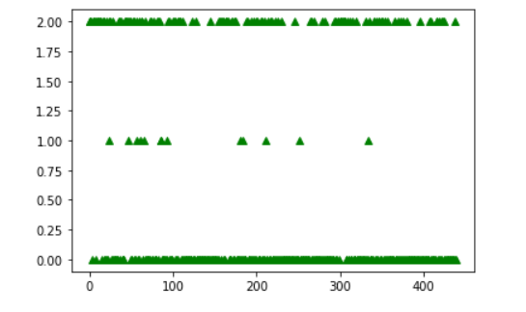
Cluster Visualization1:
Cluster0: Maximum number of customers belong to this cluster
Cluster1: Very few number of customers belong to this cluster
Cluster2: second highest cluster in terms of number of customers
Clusters
No of customers

Slide 6
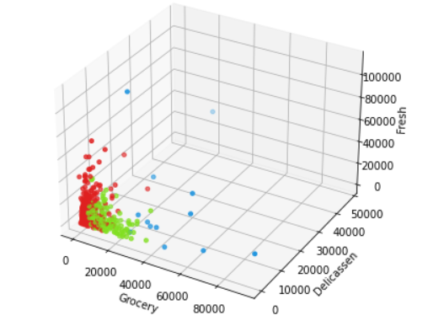
Cluster Visualization2:
All type of customers consume the following products – Fresh, Grocery and Delicassen. But the spending amount is varing for different clusters.

Slide 7
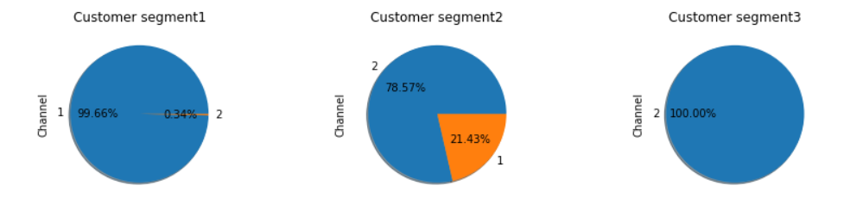
Channel-wise Cluster Visualization:
Cluster1: 99.66% belong the Channel1, i.e Hotels/Restaurants/Café etc (B2B)
Cluster2: There are some overlap present in this cluster. Most of the customers are of type Channel1 and rest are of type Channel2 (79%% B2B and 21% B2C)
Cluster3: 100% belong the Channel2, i.e the retail customers or the individual buyers (B2C)

Slide 8
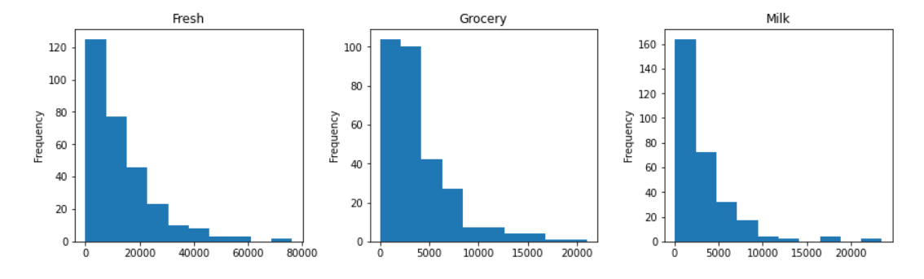
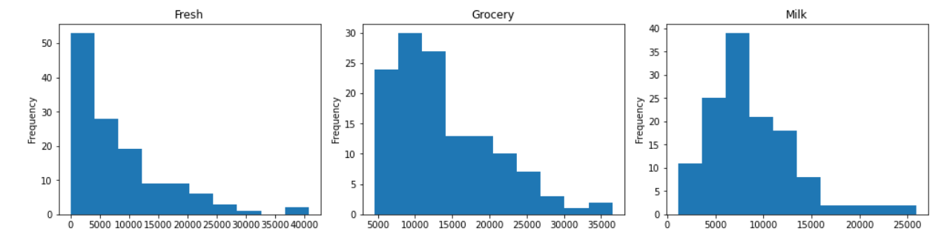
Spending amount wise Customer Segmentation: Cluster1 (B2B)
Among all the essential product categories the average annual spending looks significantly high for 'Fresh' items in comparison to other items.
Which is of no surprise because Hotel/Restaurant/Cafe etc need fresh vegetables/fruits on daily basis for food preparation.
Spending amount wise Customer Segmentation: Cluster3 (B2C)
Among all the essential product categories the average annual spending looks significantly high for 'Grocery' items and 'Milk' in comparison to 'Fresh' items.

Slide 9
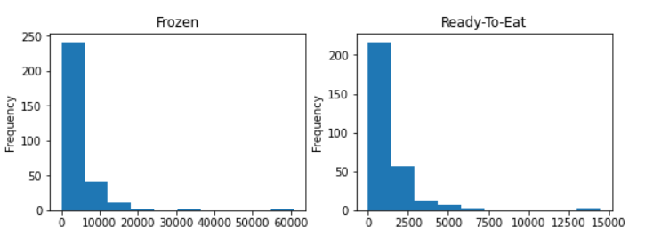
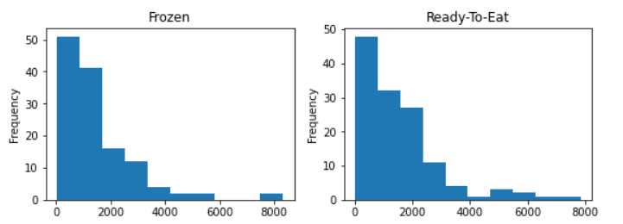
Spending amount wise Customer Segmentation: Cluster1 (B2B)
As expected, the annual spending for 'Delicassen' or Ready-to-eat items for business customers is very low.
Spending amount wise Customer Segmentation: Cluster3 (B2C)
In comparison to business customers, the retail customers spend significantly high amount on ready-to-eat products.
But Frozen items are consumed by both the type of the customers. The only difference is that there are very few business customers who spend significantly high amount for Frozen items.

Slide 10
Key takeaways From The Cluster Analysis:
1. Customer Segment1 or Clsuter1 : Consists of the Business customers (B2B) like Hotel/Restaurant/Cafe
2. Customer Segment2 or Clsuter2 : Consists of the Retail customers (B2C) like individual buyers
3. Customer Segment3 or Clsuter3 : Very few number of customers belonging to both the above category
Let’s look at the insights received from the on customer segment1 (B2B): segmentation done by locations/regions, segmentation based on different product lines:
Question1: Is there scope of business expansion according to Region of the customers?
Business customers belong to different regions. But among all the regions 'Oporto' has the lowest number of such customers. Hence, there can be a scope of business expansion in this region.
Question2: What insights we can get from the purchase patterns based on product categories (Essential items)?
Among all the essential product categories the average annual spending looks significantly high for 'Fresh' items in comparison to other essential items such as 'Grocery’, 'Milk' etc. Which is of no surprise because Hotel/Restaurant/Cafe need fresh vegetables/fruits on daily basis for food preparation.
Question3: What insights we can get from the purchase patterns based on product categories (Frozen items/Ready-to-eat items)?
As expected, the annual spending for 'Delicassen' or Ready-to-eat items for business customers is not significant. On the other hand, there are few customers who are spending significantly high amount for Frozen food.

Slide 11
Key takeaways From The Cluster Analysis :
Let’s look at the insights received from the on customer segment2 (B2C): segmentation done by locations/regions, segmentation based on different product lines:
Question1: Is there scope of business expansion according to Region of the customers?
Only 25% of the retail customers belong to the regions 'Lisbon' and 'Opporto', whereas 75% belong to other regions. So, there is a scope of attracting more retail customers in these two regions.
Question2: What insights we can get from the purchase patterns based on product categories (Essential items)?
For this customer segment, among all the essential items the average annual spending looks significantly high for 'Grocery' and 'Milk' in comparison to 'Fresh' items.
Question3: What insights we can get from the purchase patterns based on product categories (Frozen items/Ready-to-eat items)?
In comparison to business customers, the retail custmers spend significantly high amount on ready-to-eat products. But Frozen items are consumed by both the type of the customers. The only difference is that there are few business cutomers who spend significantly high amount for Frozen items. It seems that proactive lifestyle has urged all type consumers to depend on frozen food products. So, this seems to be a crucial product segment to meet the need of both type of the customers.

Slide 12
Strategies or plan of actions:
Based on cluster analysis the wholesaler can take actions or decisions to identify the areas of improvements and can expand it’s business as well:
Strategies for B2B customers:
The majority of the customers of this wholesaler are the business customers like Hotels/Restaurants/Café etc. As expansion strategy the wholesaler can look for more customers in region like Oporto after giving due diligence for the points such as - research if the market is already saturated in that region or not, research about the existing competitors in that region, population growth in that area etc.
This segment of customer spend significantly high amount on Fresh products in comparison to other products. At the same time, they also spend decent amount on Frozen items too. So, the wholesaler may want to build long term relationship/contract with the local distributors and food manufacturers to optimize it's inventory for these products. It will not only assure the regular replenishment of the items but also it will minimization the unnecessary storage.
Strategies for B2C customers:
There is a scope of attracting more retail customers in regions like Lisbon and Oporto. The wholesaler may need to do research that specific region's market share by itself and by it's competitors. Region specific research on customers average income, send customized offers, electronic coupons generation, customized service like home delivery option, sales promotions, focus on advertisements, feedback from customers etc.
Most of the spending for this segment is for day-to-day items like - Grocery and Milk. At the same time, we also observed that such customers are depending on Frozen and ready-to-eat items as well.
Frozen items are consumed by both the type of the customers. The only difference is that there are few business customers who spend significantly high amount for Frozen items. It seems that proactive lifestyle has urged all type consumers to depend on frozen food products. So, this seems to be a crucial product category to meet the demand of both type of the customers.

Slide 13
Thank you

